Slide 1
Getting started with Data Science
July 7, 2021

Slide 2
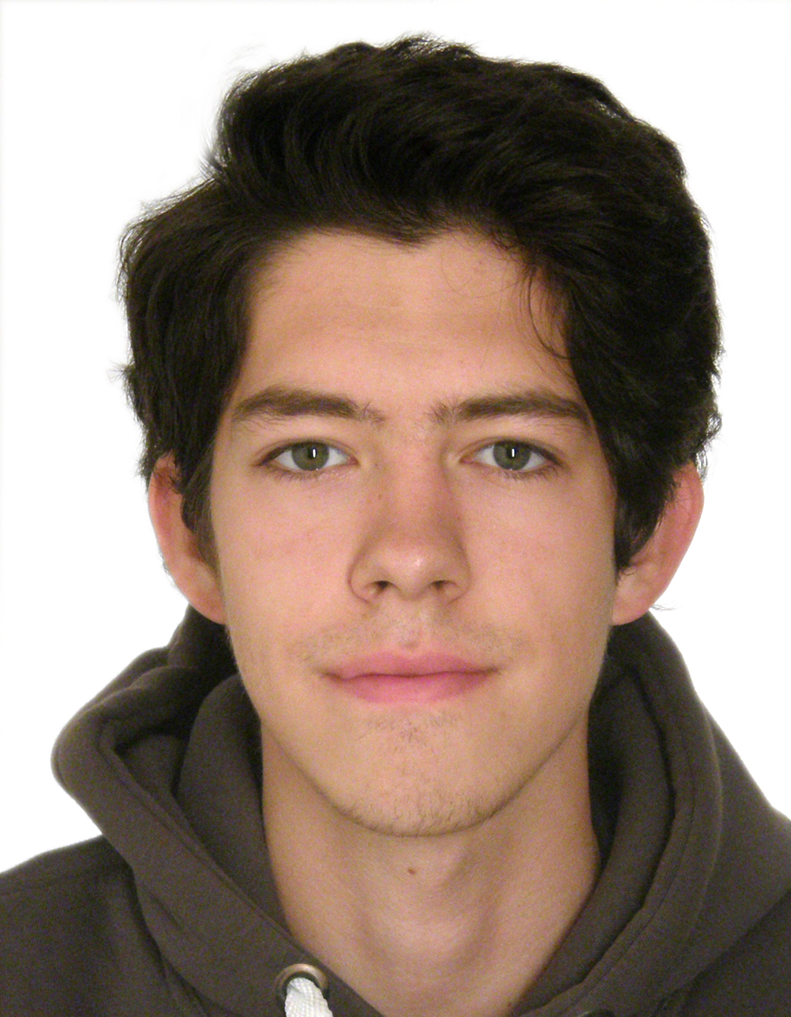
Who am I?
Bachelor’s degree in Applied Mathematics and Informatics
Master’s degree in Data Science
Conducted course on Deep Learning in HSE university. Materials of course: https://www.coursera.org/learn/intro-to-deep-learning
Previously worked in Deloitte (Dubai + Moscow)
Work in Careem since March, 2020

Slide 3
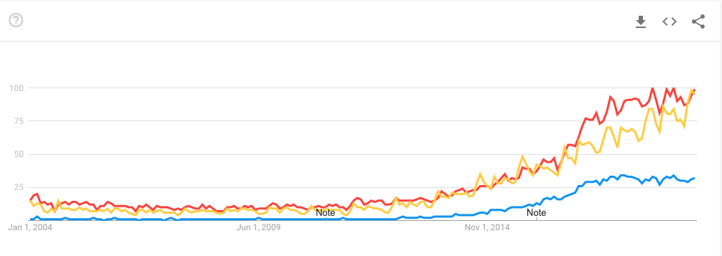
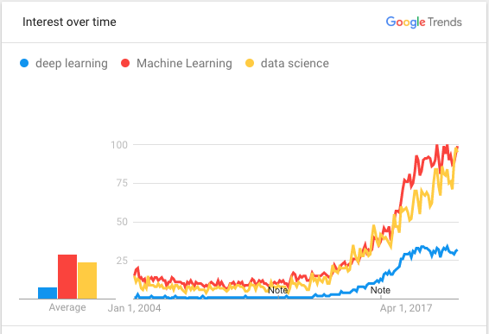
Current trends:

Slide 4

Why do we want machines to learn?

Slide 5
Simple Example:
Billy wants to buy a car. He went over dozens of ads and learned that:
New cars are around $20,000
Used year-old ones are $19,000
2-year old are $18,000 and so on
Billy, our brilliant analytic, starts seeing a pattern: so, the car price depends on its age and drops $1,000 every year
=> Regression!

Slide 6
Cars have different manufacturer, technical condition, seasonal demand spikes, and god only knows how many more hidden factors.
An average Billy can't keep all that data in his head while calculating the price. Me too.
Problem:
People are lazy => force machine to find patterns => birth of machine learning

Slide 7
Another Examples:
Rental prices in Dubai (whatever city)
Telecom: prediction of client’s leave
Forecasting of Traffic jams
ATM withdrawal requests
Detect Spam emails
Model will find pattern in data
We need data to train the model!

Slide 8
If there is no dependency in the data even the best algorithm won't help (garbage in – garbage out)
Most important nuance:

Slide 9
Who is Data Scientist?
Math:
Linear Algebra
Mathematical Analysis
Probability Theory
Statistics
Machine Learning
Deep Learning (aka Neural Networks)
Dev:
Programming (Python/R)
Algorithms and Data Structures
SQL
…
Domain:
Communication skills
Understanding of business processes

Slide 10
Skills
(OPTIONAL) STEP 04: Advanced ML
Build your own Neural Networks and train them for classification/regression tasks
STEP 03: Dev skills
Learn how to synchronize code, deploy models in production
Learn how to build models and handle with data
STEP 02: ML Applied
STEP 01: Basics
Learn basics in SQL and Python (or R)
STEP 0: Theory
Analysis, Algebra, Prob. Theory and ML

Slide 11
Other possible jobs:

Slide 12
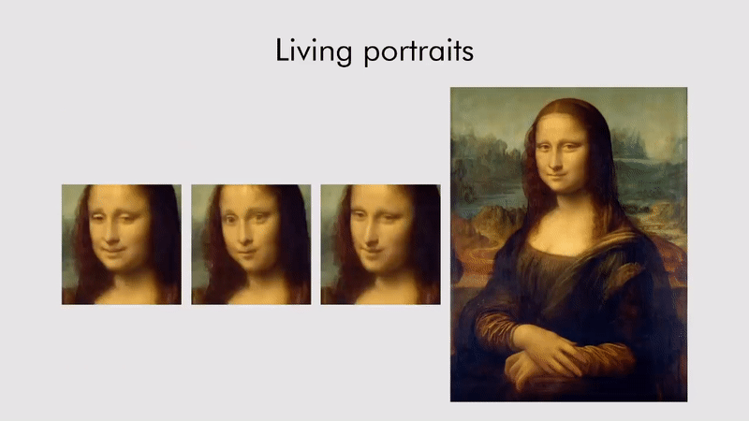
More motivating examples: Generative adversarial networks

Slide 13
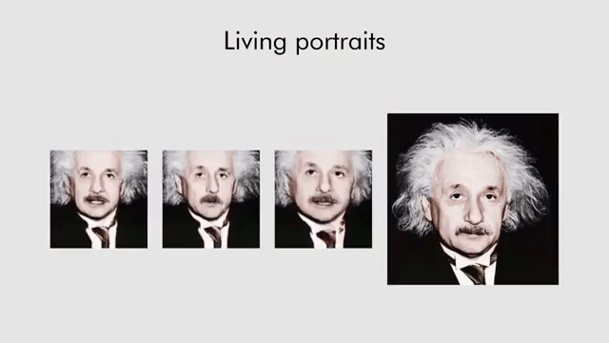
More motivating examples: Generative adversarial networks

Slide 14
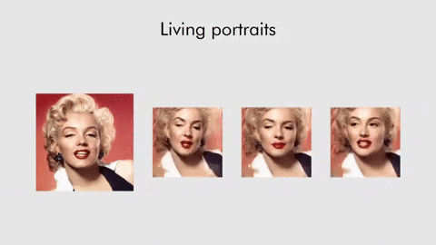
More motivating examples: Generative adversarial networks

Slide 15
Example of a project
Aim of the project:
Detect buildings on satellite images
Match them with internal client Database and find illegal buildings

Slide 16
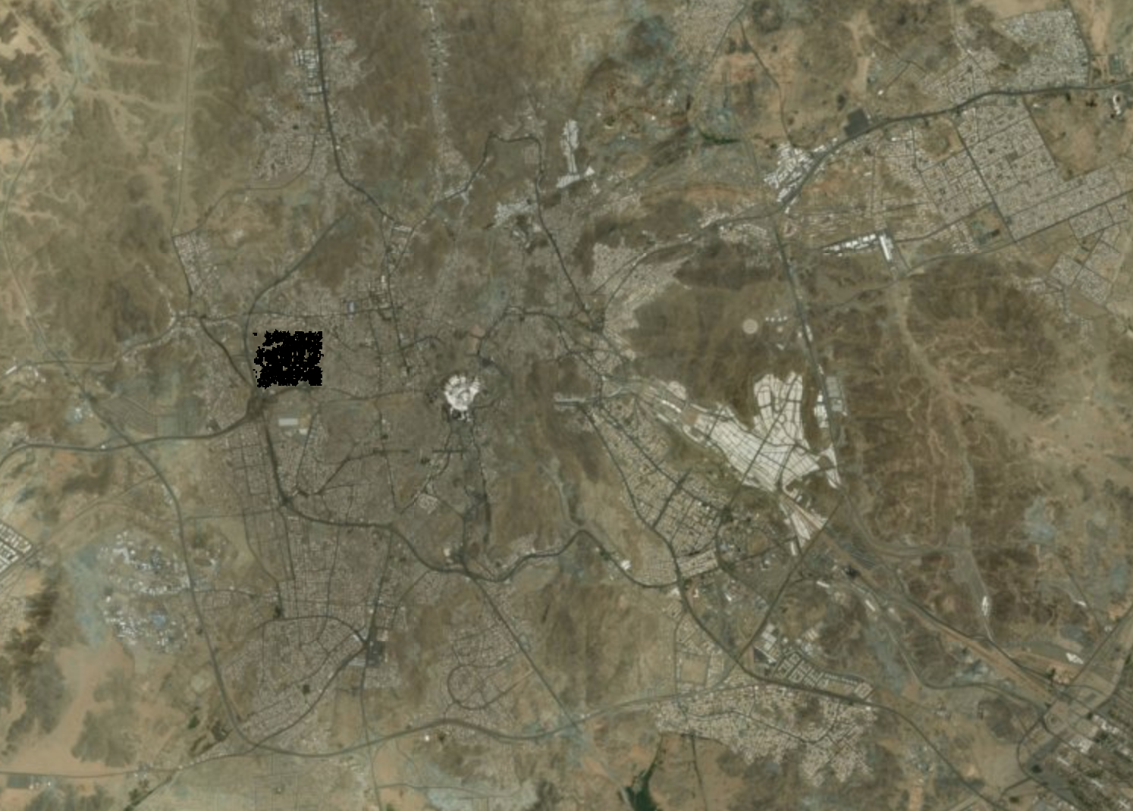
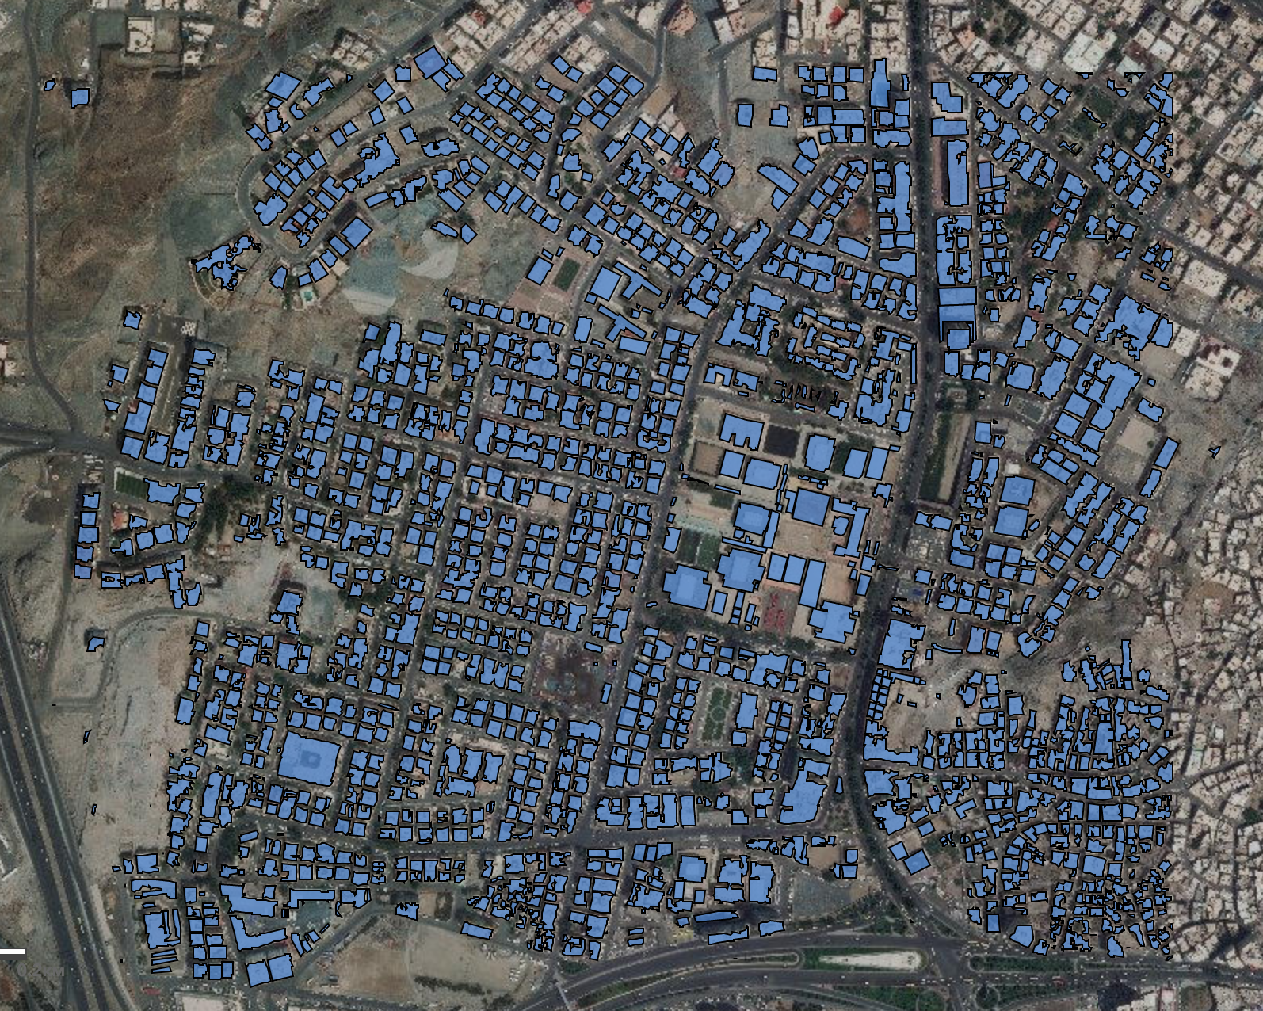
Example of a project
Manually mark Dataset of Buildings
Data Gathering
Data Preparation
Model Building
Model Validation
Model Deployment

Slide 17
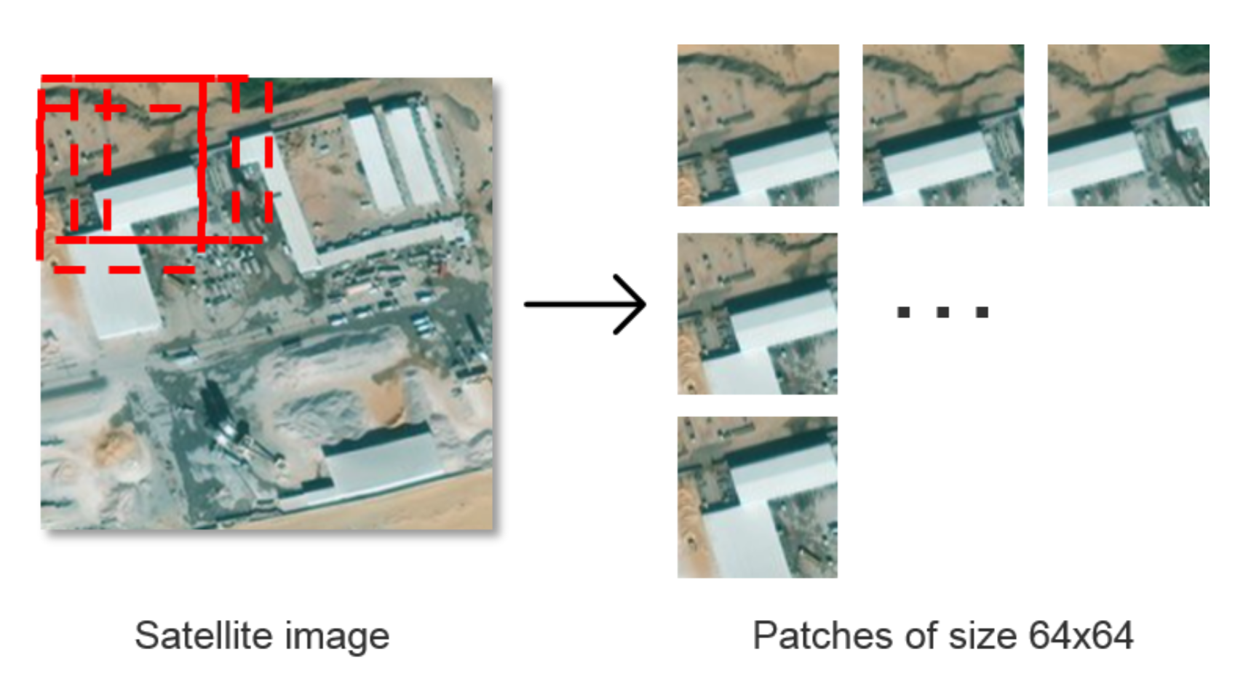
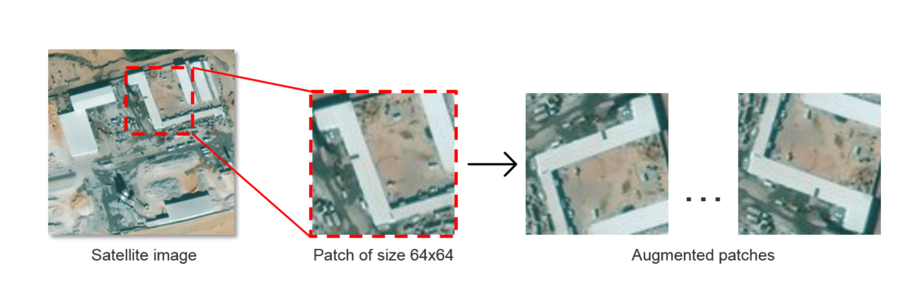
Example of a project
Curt large Images onto small parts + rotations
Data Gathering
Data Preparation
Model Building
Model Validation
Model Deployment

Slide 18
Example of a project
Try to train several Neural Networks
Data Gathering
Data Preparation
Model Building
Model Validation
Model Deployment

Slide 19
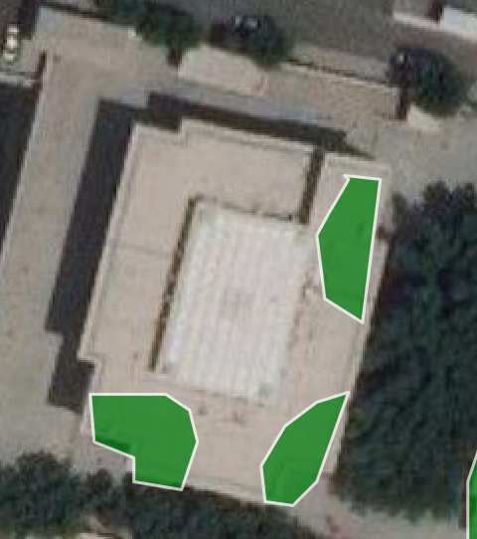
Example of a project
Validate your model on unseen images, add them to training dataset and repeat training again
Data Gathering
Data Preparation
Model Building
Model Validation
Model Deployment

Slide 20
Example of a project
Deploy model to Server
Data Gathering
Data Preparation
Model Building
Model Validation
Model Deployment

Slide 21
Summary: path to DS
Mathematics
Python/R basics
Machine Learning libraries
Advanced Machine Learning libraries
Developer skills

Slide 22
AI Everything
Link: https://www.gitex.com/
17 – 21 Oct 2021

Slide 23
Contacts
dmitryhse@gmail.com
https://ae.linkedin.com/in/dmitry-denisov-022102103

